Slide 1
Starting and Speed Control of Three-Phase Induction Motors:
Need for starter.
Direct on line.
Star-Delta.
Autotransformer starting.
Rotor resistance starting.
Speed control of 3phase induction motors
by voltage.
Frequency.
Rotor resistance methods

Slide 2

Need for starter.
In a three phase induction motor, the magnitude of an induced e.m.f. in the rotor circuit depends on the slip of the induction motor.
This induced e.m.f. effectively decides the magnitude of the rotor current.
The rotor current in the running condition is given by,

Slide 3
Need for starter.
But at start, the speed of the motor is zero and slip is at its maximum i.e. unity. So magnitude of rotor induced e.m.f. is very large at start.
As rotor conductors are short circuited.
The large induced e.m.f. circulates very high current through rotor at start.

Slide 4
Need for starter.
In a three phase induction motor, when rotor current is high, consequently the stator draws a very high current from the supply.
This current can be of the order of 5 to 8 times the full load current, at start.
Due to such heavy inrush current at start there is possibility of damage of the motor winding.
Similarly such sudden inrush of current causes large line voltage drop.
Thus other appliances connected to the same line may be subjected to voltage spikes which may affect their working.

Slide 5
Need for starter.
To avoid such effects, it is necessary to limit the current drawn by the motor at start.
The starter is a device which is basically used to limit high starting current by supplying reduced voltage to the motor at the limit of starting.
Such a reduced voltage is applied only for short period and once rotor gets accelerated, full normal rated voltage is applied.

Slide 6
Starting of Three-Phase Induction Motors:
Direct on line starter
Stator resistance starter
Auto-transformer starter
Star-delta starter
Rotor resistance starter

Slide 7
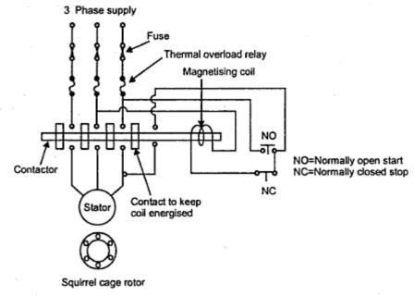
Direct on line starter
In case of small capacity motors having rating less than 5 HP, the starting current is not very high and such motors can withstand such starting current without any starter. Thus there is no need to reduce applied voltage, to control the starting current.
Though this starter does not reduce the applied voltage, it is used because it protects the motor from various severe abnormal conditions like over loading, low voltage, single phasing

Slide 8
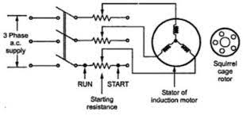
2.Stator resistance starter

Slide 9
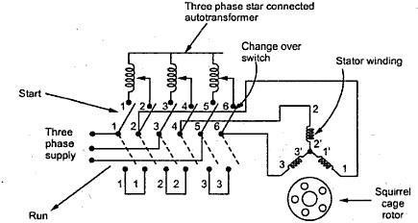
3.Auto-transformer starter

Slide 10
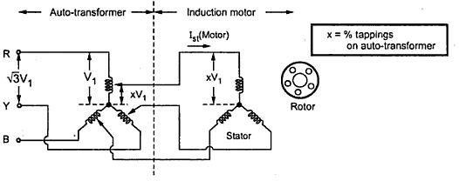
3.Auto-transformer starter
Fig.2 Use of auto-transformer to reduce voltage at start

Slide 11
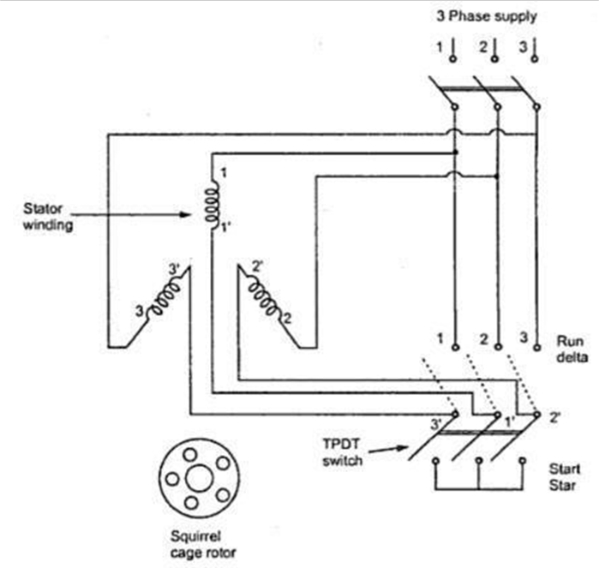
4.Star-Delta Starter

Slide 12
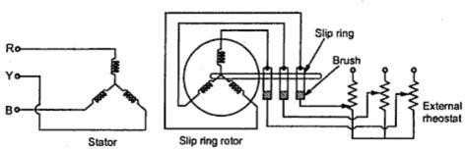
5.Rotor resistance starter

Slide 13
Speed Control of Three Phase Induction Motor:
Thus speed of the induction motor can be controlled by basically two methods :
From stator side and
From rotor side
From stator side, it includes following methods :
Supply frequency control to control Ns, called V / f control.
Supply voltage control.
Controlling number of stator poles to control Ns.
Adding rheostats in stator circuit.
From rotor side, it includes following methods :
Adding external resistance in the rotor circuit.
Cascade control.
Injecting slip frequency voltage into the rotor circuit.

Slide 14
Speed Control of 3 Phase Induction Motor:
Ns=[120f/P]-----------------1
&
S=[(Ns-N)/Ns]---------------------2
N = Ns (1 - s)-------------------3
From this expression it can be seen that the speed of induction motor can be changed either by changing its
synchronous speed (Ns)or by changing the slip s.
So as the parameters like R2, E2 are changed then to keep the torque constant for constant load condition, motor reacts by change in its slip. Effectively its speed changes.

Slide 15

From stator side Supply Frequency Control or V / f Control:
Fig. 1 Electronic scheme for V/f control

Slide 16
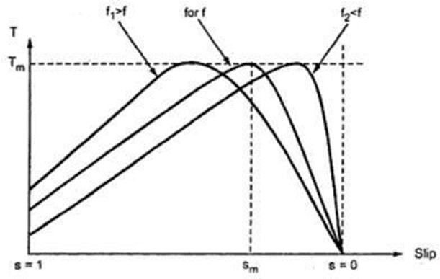
Torque-slip characteristics with variable f and constant (V/f)

Slide 17
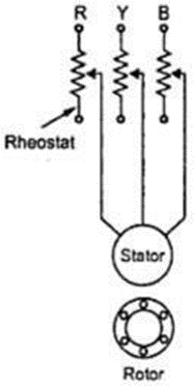
Adding Rheostats in Stator Circuit:

Slide 18
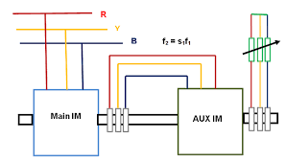
Cascaded control

